Slide 1
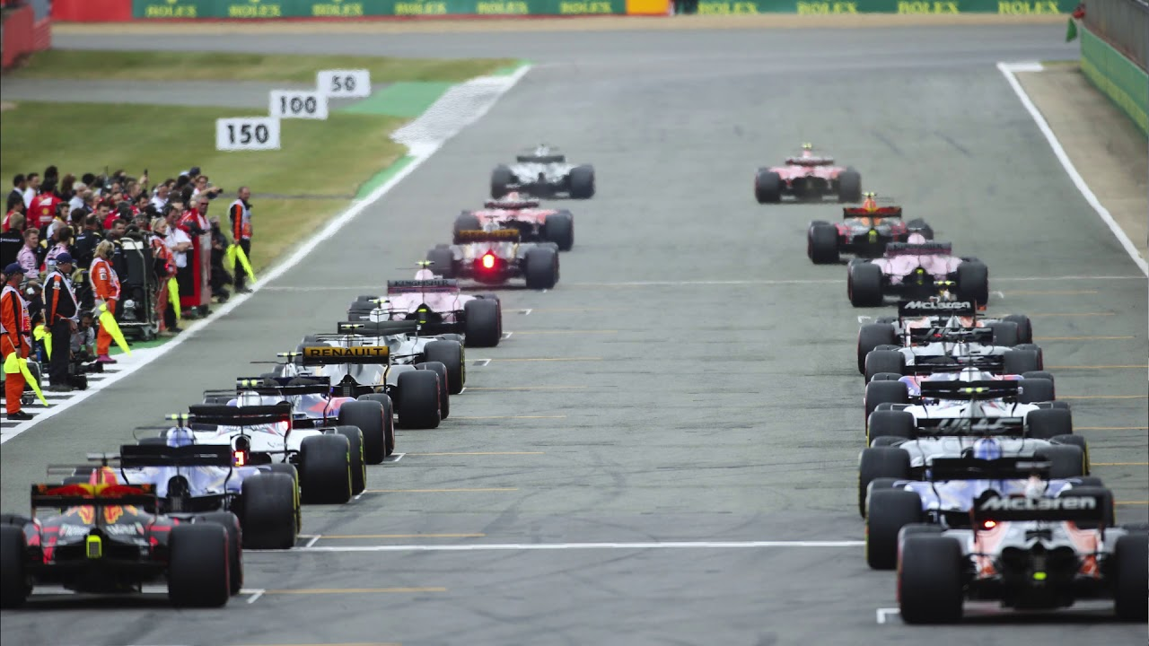
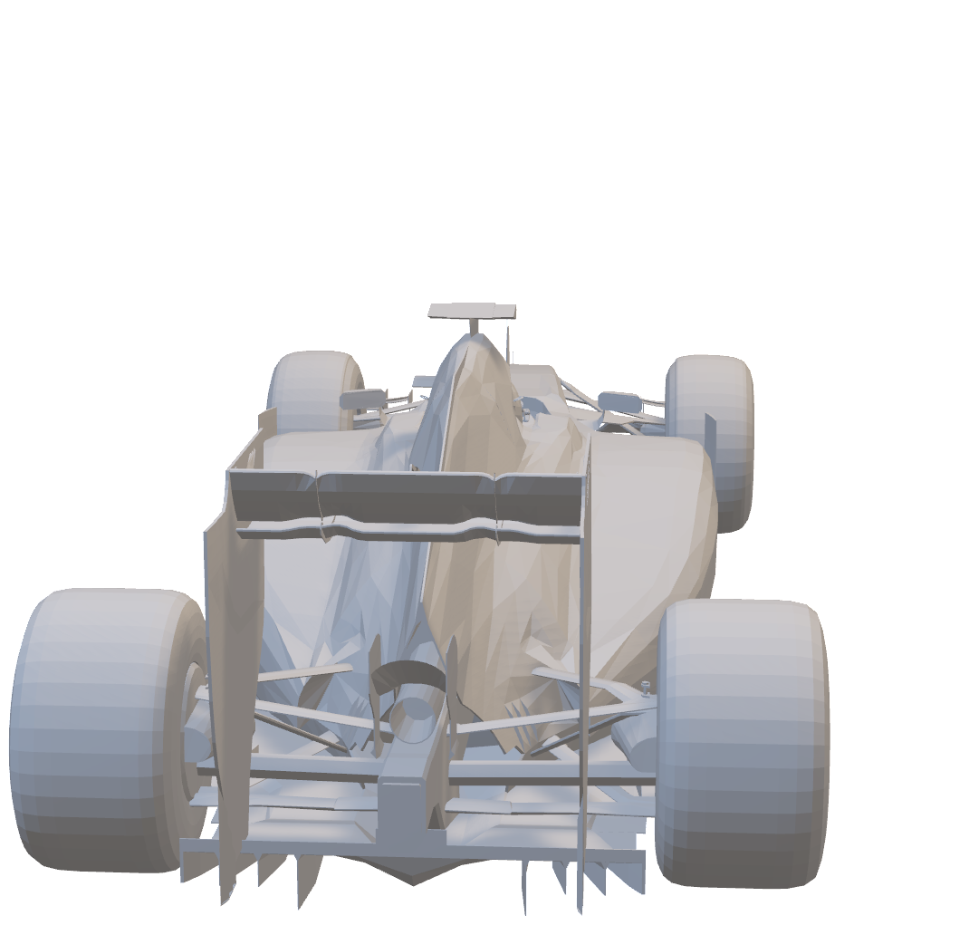
Formula 1

Slide 2
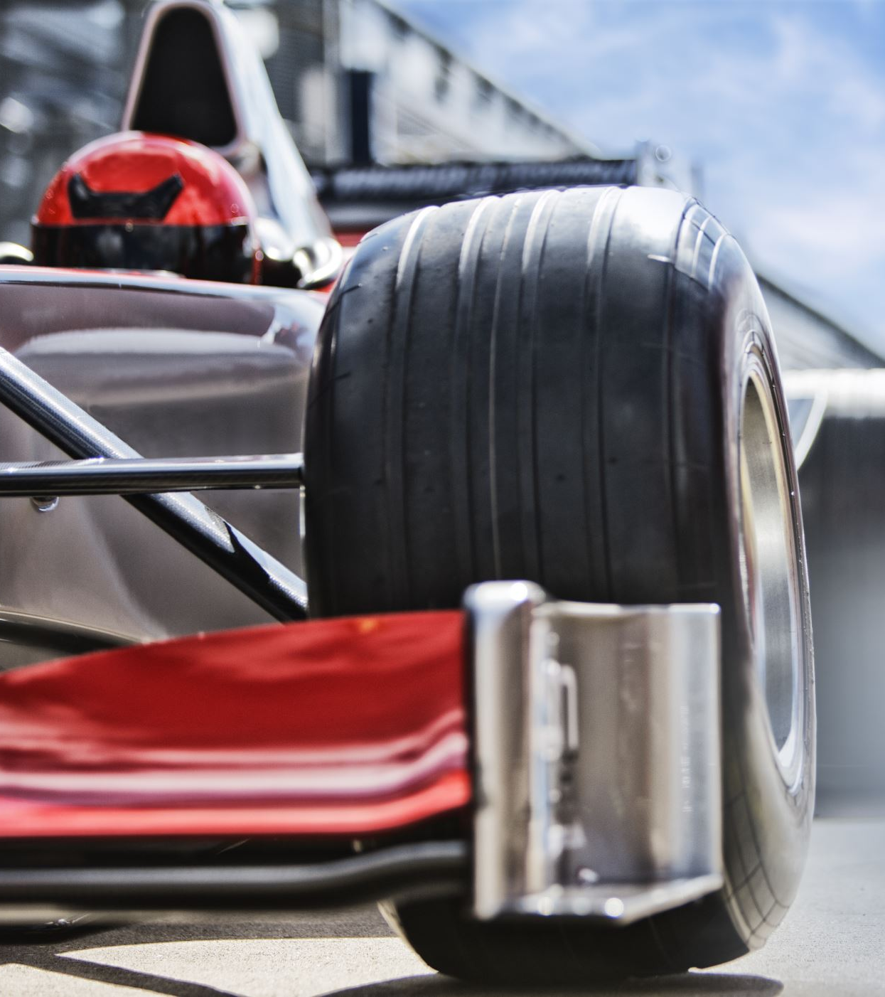
Formula One
The main competition of single seater cars
Every kids who loves mechanic sport will enjoy Formula One
More entertainment than some series

Slide 3
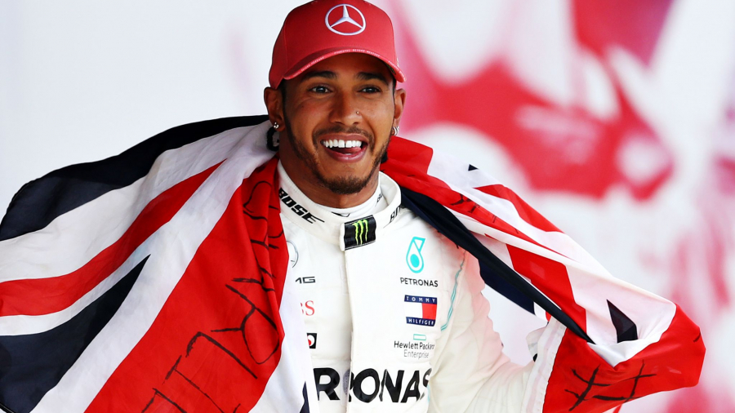
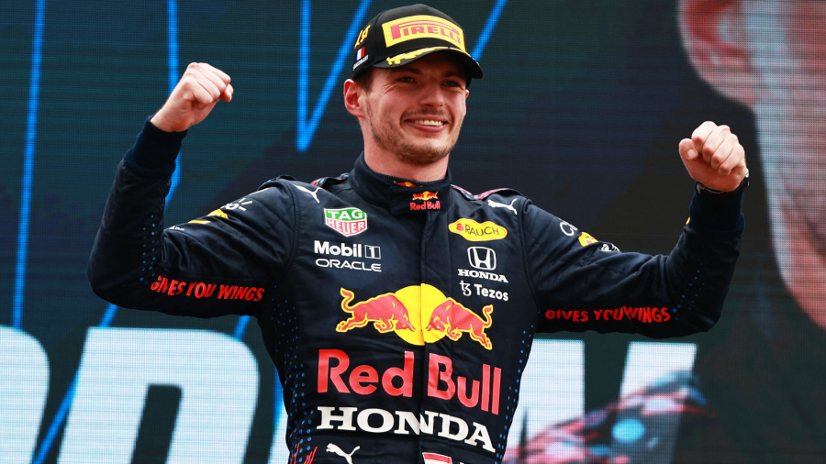
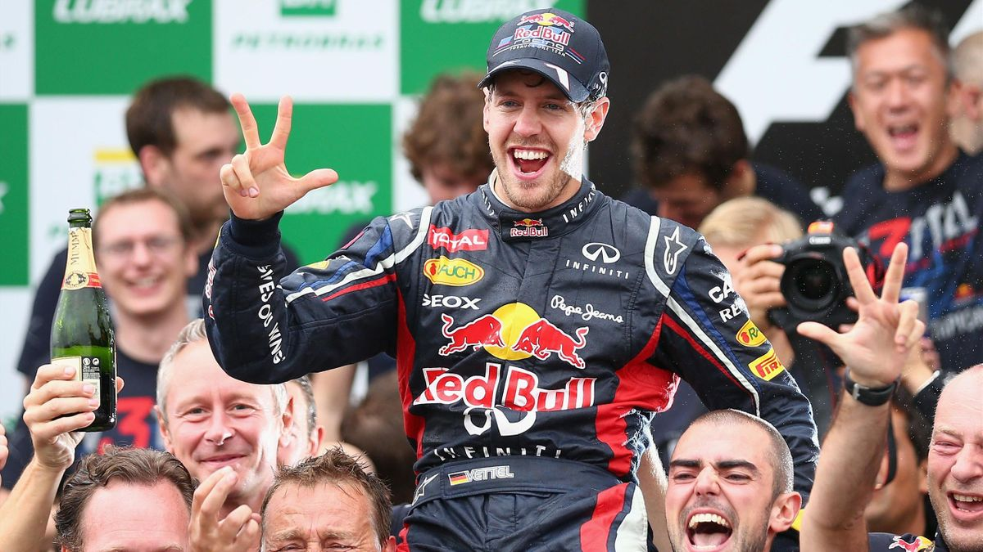
Rules of Formula 1
145M are allow for every team for developing the car
Every teams gain some money to finish higher in the constructor’s Championship
The driver who scored most points than his opponents win the Driver Championship

Slide 4
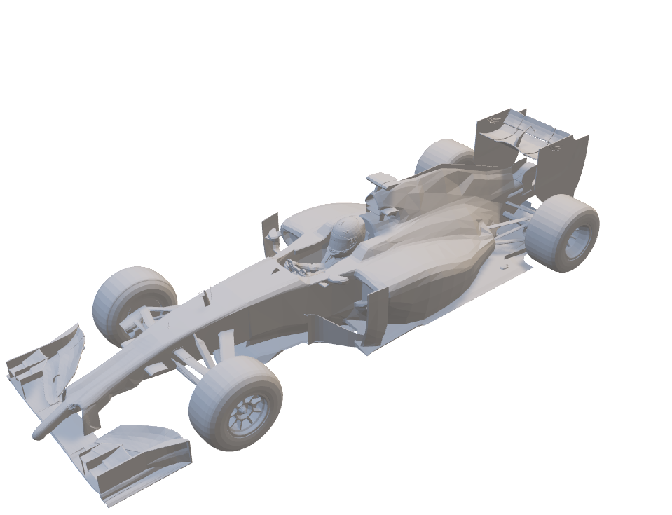
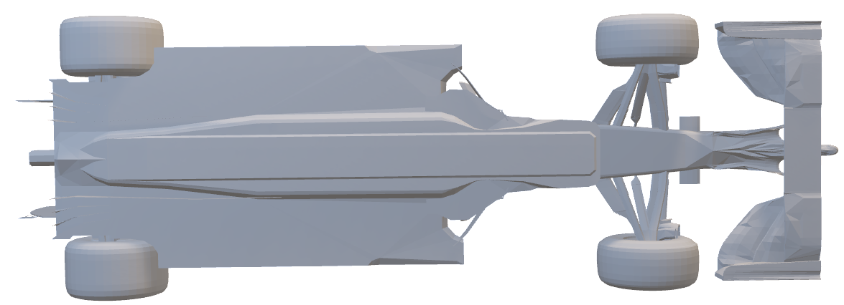
Formula one CAR

Slide 5
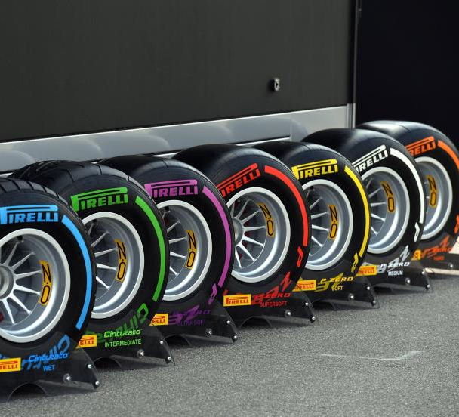
The Tyres
2 types of wet tyres:
Inter
Wet
5 types of slick tyres:
Only 3differents types for the WE

Slide 6
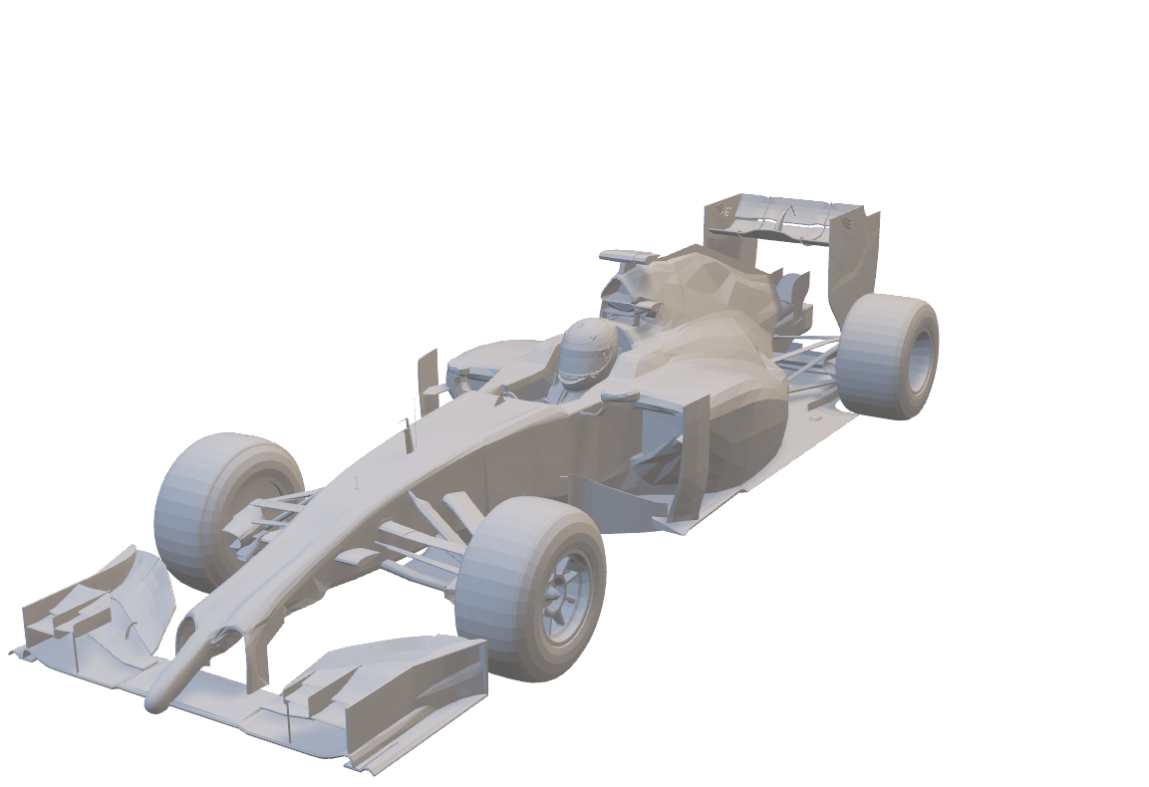
Needed for every GP week-end
13 sets of slick tyres for the WE
2 differents set of slick tyres for the race
The race is during 305 km or 2 hours

Slide 7
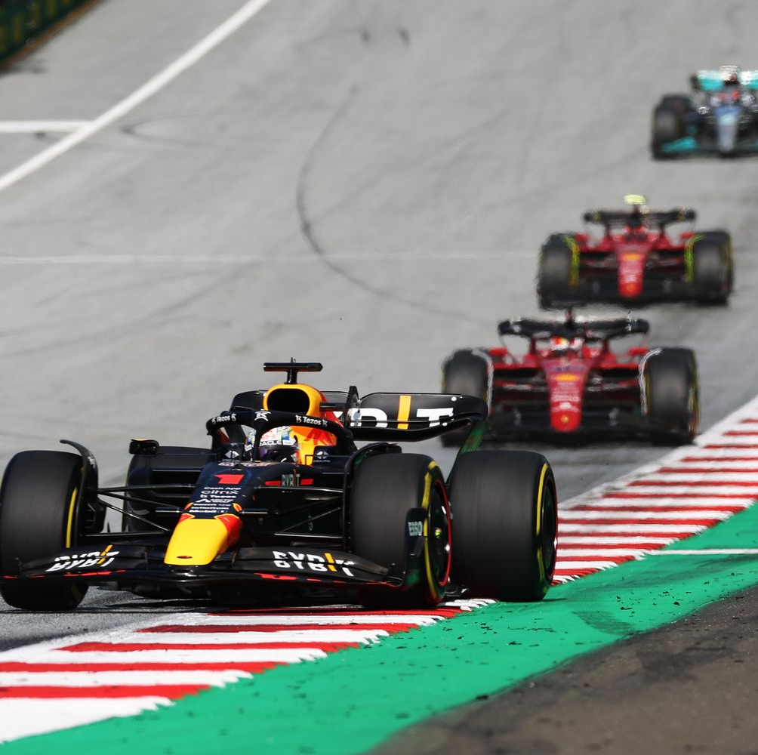
Schedule of a Grand Prix weekend
Friday: 2 free practice session of 1 hour
Saturday: 1 free practice session of 1 hour, 1 qualifying session
Sunday: Race Day

Slide 8
Free practice
having the best setup for the race
Tests some new pieces to developing the car
Judge the tyres rubber grip
Search the limit of the grip on the track

Slide 9
Qualifying session
20
19
18
17
16
15
14
13
12 11
10
9
8
7
6
5
4
3
2
1 the pole setter 👑
3 mini session of 18, 15, 11 minutes:
The bottom 5 drivers are eliminated of the first part of the qualification (20-16)
Q1 time
The bottom 5 drivers are eliminated of the second part of the qualification(15-11)
Q2 time
The 10 last drivers for the 10 first places(10-1)
Q3 time

Slide 10
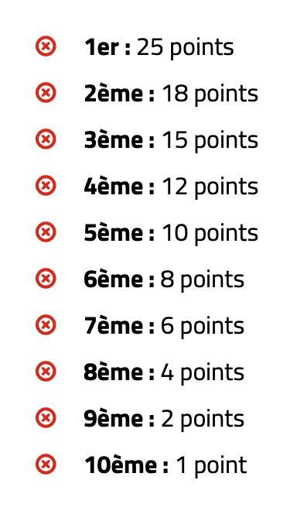
Points distribution
In 2020, a point is decerned for the best lap time in the race, it count only if you are in the TOP 10.
In 2021, sprint races added in race weekend, and it gives 8 to 1 point for the 8 first drivers in the sprint races.

Slide 11
Security on the track
Three big systems already add in the sport
The Halo
The safety car/ medical car
The marshals waving

Slide 12
ThE halo
Image bus sur le halo

Slide 13
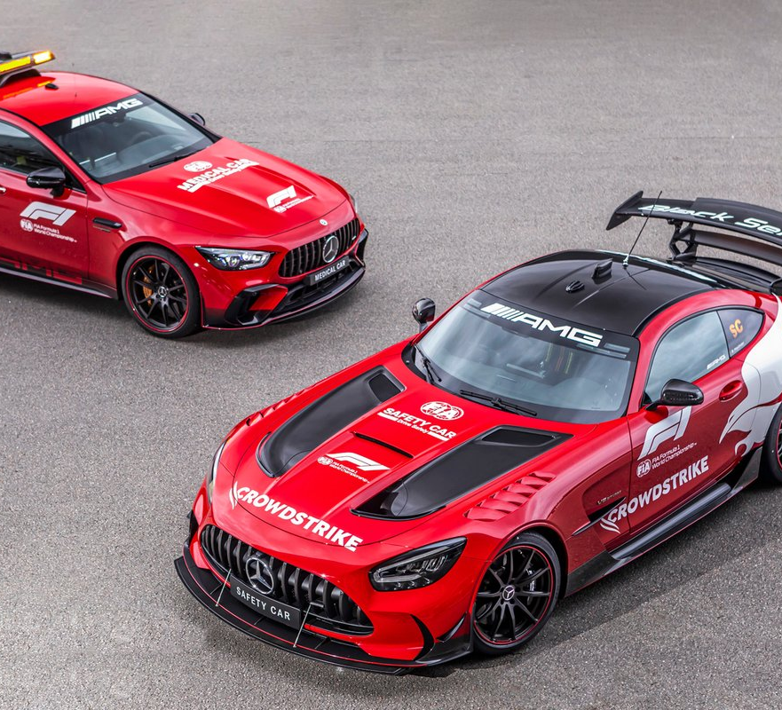
Safety cAR / medical car
Speed limited for the safety on the track
Professionnal driver on board (Bernt Maylander)
First add in 1971

Slide 14
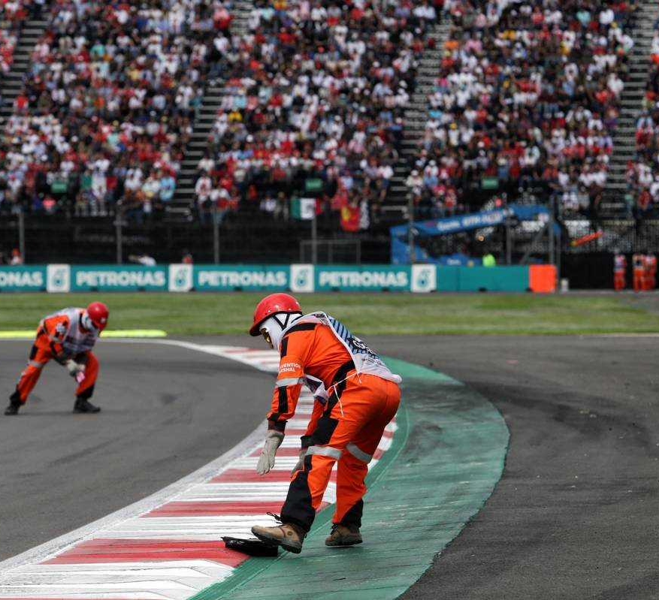
MARSHALLS ROLE
Clean the track when there is some debris
Wave some flags to announce a danger forward

Slide 15
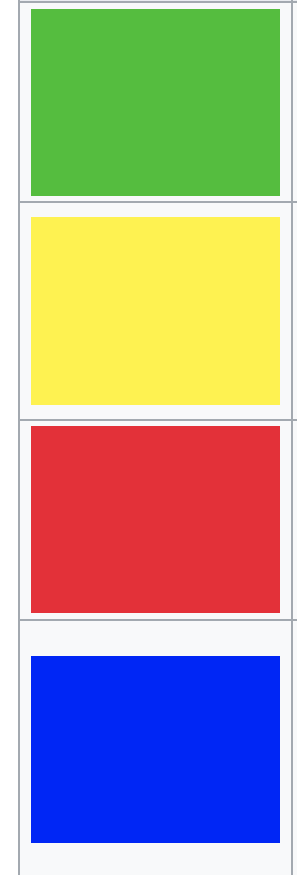
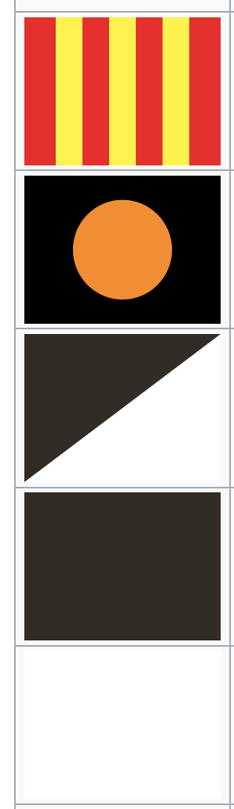
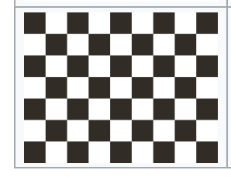
FLAGS
The race is underway
There is a problem on the track
The race is stopped
With car number, agitated to a latecomer
Session is finished
change of grip on the track(oil or fluid)
With car number, Dangerous element on a car
With car number, Dangerous movement
Disqualification
Slowing down for safety on the track

Slide 16
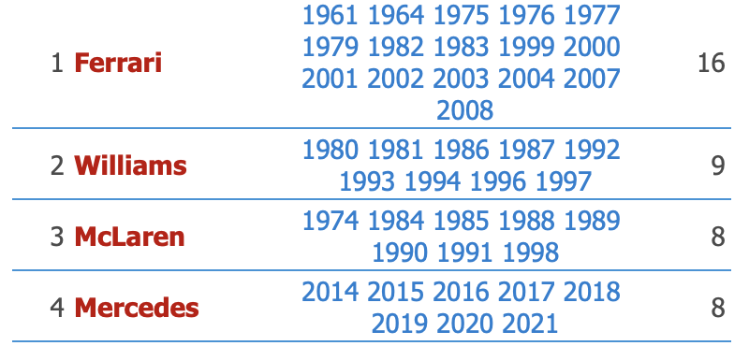
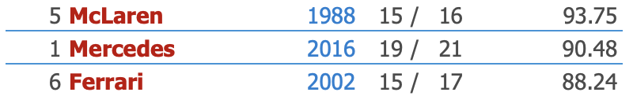
SOME STATS
Number of Constructor Championship Wins:
Pourcents of winrate in a season:

Slide 17

MORE STATS
Most wins: Lewis Hamilton 103
Most Pole: Hamilton 103
Numbers of drivers Championship:
Hamilton/Schumacher -> 7,
Fangio -> 5,
Vettel/Prost -> 4
-Youngest winner: Max Verstappen 18 years and 228 days
-Youngest pole setter: Seb Vettel 21 years, 2 month et 11 days
-Pourcents of points in a season: 83,58 -> 397 /475 (Vettel 2013)
-Number of victories in a season:
-13 for Vettel(2013 with 19 GP)
-13 for Schumacher(2004 with 18 GP)
-14 for Max this year (2022 with 23 GP)

